Slide 1
INTRODUCTION
CHAPTER 1
SOURCE :- Database System concepts , 6ed , Silberschatz, Korth, Sudarshan

Slide 2
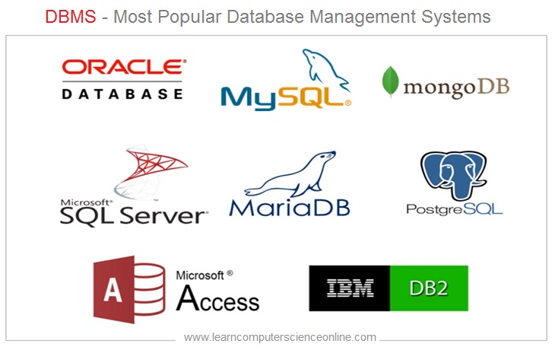
What is DBMS?
INTRODUCTION
A database-management system (DBMS) is a collection of interrelated data and a set of programs to access those data.
The collection of data, usually referred to as the database, contains information relevant to an enterprise.
The primary goal of a DBMS is to provide a way to store and retrieve database information that is both convenient and efficient
Sudha Bhagavatheeswaran, Department of Information Technology,
SIES College of Arts, Science & Commerce (Autonomous)

Slide 3
Applications
INTRODUCTION
Enterprise Information
  Sales: For customer, product, and purchase information.
  Accounting: For payments, receipts, account balances, assets and other accounting information.
  Human resources: For information about employees, salaries, payroll taxes, and benefits, and for generation of paychecks.
  Manufacturing: For management of the supply chain and for tracking production of items in factories, inventories of items in warehouses and stores, and orders for items.
  Online retailers: For sales data noted above plus online order tracking, generation of recommendation lists, and maintenance of online product evaluations
Sudha Bhagavatheeswaran, Department of Information Technology,
SIES College of Arts, Science & Commerce (Autonomous)

Slide 4
Applications
INTRODUCTION
Banking and Finance
  Banking: For customer information, accounts, loans, and banking transactions.
  Credit card transactions: For purchases on credit cards and generation of monthly statements.
  Finance: For storing information about holdings, sales, and purchases of financial instruments such as stocks and bonds; also for storing real-time market data to enable online trading by customers and automated trading by the firm.
Sudha Bhagavatheeswaran, Department of Information Technology,
SIES College of Arts, Science & Commerce (Autonomous)

Slide 5
Applications
INTRODUCTION
Universities: For student information, course registrations, and grades (in addition to standard enterprise information such as human resources and accounting).
Airlines: For reservations and schedule information. Airlines were among the first to use databases in a geographically distributed manner.
Telecommunication: For keeping records of calls made, generating monthly bills, maintaining balances on prepaid calling cards, and storing information about the communication networks.
Sudha Bhagavatheeswaran, Department of Information Technology,
SIES College of Arts, Science & Commerce (Autonomous)

Slide 6
Purpose of Database Systems
INTRODUCTION
File processing system :- store information in operating system files
Database Systems:- Relational concept to store information
Disadvantages of File Processing/ Advantages of Database Systems
  Data redundancy and inconsistency
  Difficulty in accessing data
  Data isolation
  Integrity problems
  Atomicity problems
  Concurrent-access anomalies
  Security problems
Sudha Bhagavatheeswaran, Department of Information Technology,
SIES College of Arts, Science & Commerce (Autonomous)

Slide 7
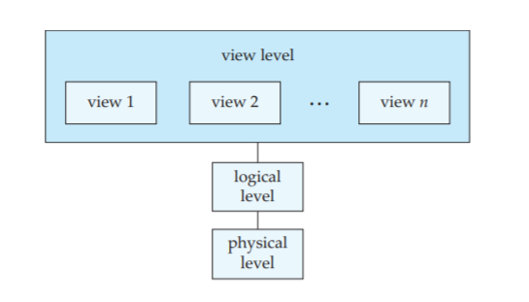
View of Data - Data Abstraction
INTRODUCTION
Physical level. The lowest level of abstraction describes how the data are actually stored
Logical level. The next-higher level of abstraction describes what data are stored in the database, and what relationships exist among those data
View level. The highest level of abstraction describes only part of the entire database
Sudha Bhagavatheeswaran, Department of Information Technology,
SIES College of Arts, Science & Commerce (Autonomous)

Slide 8
View of Data - Instances and Schemas
INTRODUCTION
The collection of information stored in the database at a particular moment is called an instance of the database.
The overall design of the database is called the database schema.
A database schema corresponds to the variable declarations (along with associated type definitions) in a program.
Each variable has a particular value at a given instant. The values of the variables in a program at a point in time correspond to an instance of a database schema.
3 schemas
  The physical schema describes the database design at the physical level.
  The logical schema describes the database design at the logical level.
  A database may also have several schemas at the view level, sometimes called subschemas, that describe different views of the database.
Sudha Bhagavatheeswaran, Department of Information Technology,
SIES College of Arts, Science & Commerce (Autonomous)

Slide 9
Data Models
INTRODUCTION
Data model: a collection of conceptual tools for describing data, data relationships, data semantics, and consistency constraints.
A data model provides a way to describe the design of a database at the physical, logical, and view levels.
Relational Model.
  The relational model uses a collection of tables to represent both data and the relationships among those data.
  Each table has multiple columns, and each column has a unique name.
  Tables are also known as relations.
  Each table contains records of a particular type.
  Each record type defines a fixed number of fields, or attributes.
  The columns of the table correspond to the attributes of the record type.
OFFICE | CITY | REGION | MGR | TARGET | SALES
11 | Mumbai | Western | 103 | 50,000 | 30,000
22 | Pune | Eastern | 101 | 45,000 | 60,000
Sudha Bhagavatheeswaran, Department of Information Technology,
SIES College of Arts, Science & Commerce (Autonomous)
Notes:
Add your notes HERE.
This is used to add notes to my slides which I can refer to during the presentation.

Slide 10
Data Models
INTRODUCTION
Entity-Relationship Model (E-R)
  uses a collection of basic objects, called entities, and relationships among these objects.
  An entity is a “thing” or “object” in the real world that is distinguishable from other objects
Object-Based Data Model.
  Java, C++, or C has led to the development of an object-oriented data model that can be seen as extending the E-R model with notions of encapsulation, methods (functions), and object identity.
  The object-relational data model combines features of the object-oriented data model and relational data model
Sudha Bhagavatheeswaran, Department of Information Technology,
SIES College of Arts, Science & Commerce (Autonomous)

Slide 11
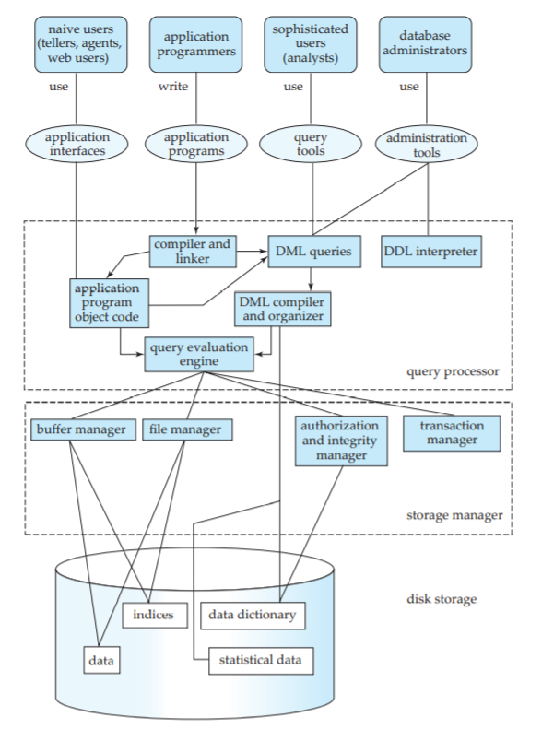
Database Architecture
INTRODUCTION
Database Users
Programs/Tools
Query Processor
Storage manager
Disk Storage
Sudha Bhagavatheeswaran, Department of Information Technology,
SIES College of Arts, Science & Commerce (Autonomous)

Slide 12

Database Users
INTRODUCTION
Naive users are unsophisticated users who interact with the system by invoking one of the application programs that have been written previously. The typical user interface for naive users is a forms interface, where the user can fill in appropriate fields of the form. Naive users may also simply read reports generated from the database.
Application programmers are computer professionals who write application programs. Application programmers can choose from many tools to develop user interfaces. Rapid application development (RAD) tools are tools that enable an application programmer to construct forms and reports with minimal programming effort.
Sophisticated users interact with the system without writing programs. Instead, they form their requests either using a database query language or by using tools such as data analysis software. Analysts who submit queries to explore data in the database fall in this category.
Specialized users are sophisticated users who write specialized database applications that do not fit into the traditional data-processing framework. Among these applications are computer-aided design systems, knowledgebase and expert systems, systems that store data with complex data types (for example, graphics data and audio data), and environment-modeling systems
Sudha Bhagavatheeswaran, Department of Information Technology,
SIES College of Arts, Science & Commerce (Autonomous)

Slide 13
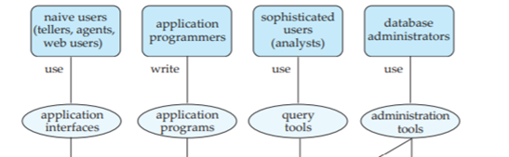
Programs/Tools
INTRODUCTION
Application interface
Application programs
Query tools
Administration tools
Sudha Bhagavatheeswaran, Department of Information Technology,
SIES College of Arts, Science & Commerce (Autonomous)

Slide 14
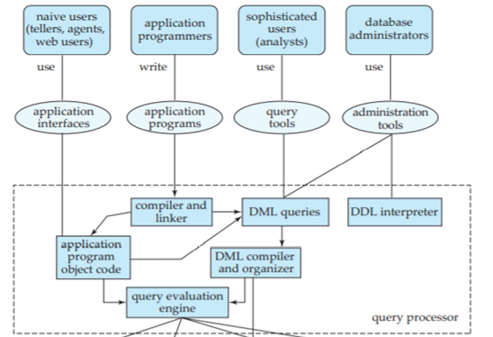
Query Processor
INTRODUCTION
DDL interpreter, which interprets DDL statements and records the definitions in the data dictionary.
DML compiler, which translates DML statements in a query language into an evaluation plan consisting of low-level instructions that the query evaluation engine understands. The DML compiler also performs query optimization; that is, it picks the lowest cost evaluation plan from among the alternatives.
Query evaluation engine, which executes low-level instructions generated by the DML compiler.
Sudha Bhagavatheeswaran, Department of Information Technology,
SIES College of Arts, Science & Commerce (Autonomous)

Slide 15
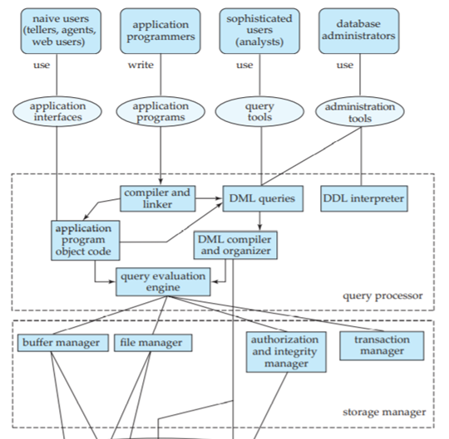
Storage Manager
INTRODUCTION
Authorization and integrity manager, which tests for the satisfaction of integrity constraints and checks the authority of users to access data.
Transaction manager, which ensures that the database remains in a consistent (correct) state despite system failures, and that concurrent transaction executions proceed without conflicting.
File manager, which manages the allocation of space on disk storage and the data structures used to represent information stored on disk.
Buffer manager, which is responsible for fetching data from disk storage into main memory and deciding what data to cache in main memory.
Sudha Bhagavatheeswaran, Department of Information Technology,
SIES College of Arts, Science & Commerce (Autonomous)

Slide 16
Disk Storage
INTRODUCTION
Data files, which store the database itself.
Data dictionary, which stores metadata about the structure of the database, in particular the schema of the database.
Indices, which can provide fast access to data items. Like the index in any book, a database index provides pointers to those data items that hold a particular value. For example, we could use an index to find the instructor record with a particular ID, or all instructor records with a particular name.
Sudha Bhagavatheeswaran, Department of Information Technology,
SIES College of Arts, Science & Commerce (Autonomous)

Slide 17
Chapter 1 ends
INTRODUCTION
WHAT WE COVERED………..
What is DBMS?
Applications
Purpose of Database Systems (File Processing /Database Systems)
View of Data - Data Abstraction
View of Data - Instances and Schemas
Data Models
Database Architecture
Sudha Bhagavatheeswaran, Department of Information Technology,
SIES College of Arts, Science & Commerce (Autonomous)

